Slide 1

Graph Searching Techniques Topological Sorting
Prepared by
Lec Shekh. Md. Saifur Rahman
PREPARED BY
SWAPNIL BISWAS

Slide 2
Graph Searching
Given: a graph G = (V, E), directed or undirected
Goal: methodically explore every vertex and every edge.
Ultimately: build a tree on the graph
Pick a vertex as the root
Choose certain edges to produce a tree
Note: might also build a forest if graph is not connected
There are two standard graph traversal techniques:
Breadth-First Search (BFS)
Depth-First Search (DFS)

Slide 3
Level of a Graph
What is level?
5
Source vertex is from Level-0
Level-0
5
Level-i+1 contains all the undiscovered adjacent vertices of Level-i
1
4
6
Level-1
1
4
6
Level is considered as the minimum distance from the source
7
2
0
3
Level-2
7
2
0
3
Level-1 vertices:
1 4 6
Level-0 vertices:
5
Undiscovered Adjacent vertices of {1,4,6}:
7 2 0 3
Undiscovered Adjacent vertices of 5:
1
4
6
So, Level-2 vertices are:
7 2 0 3
So, Level-1 vertices are:
1
4
6

Slide 4
Level of a Graph
Find the total number of levels in the graph and list down the vertices of all level considering 5 as source
Level-0 :
{5}
Level-1 :
{1, 2, 4, 6}
5
5
Level-2 :
{0, 3, 7, 8}
1
4
6
So, here number of level=3
1
4
6
In short: Level of a vertex denotes its shortest distance from the source
7
2
0
3
7
2
0
3
Levels of a graph is not fixed. It depends on the source
Here, consider vertex-0 as source and then identify different levels
8
8
Level-0 :
{0}
Level-3 :
{1,2,4}
Level-1 :
{6}
Level-4 :
{7,8}
Level-2 :
{3,5}

Slide 5
Breadth-First Search (BFS)
BFS involves visiting all the connected nodes of a graph in a level-by-level manner.
Builds a tree over the graph – BFS Spanning tree
Pick a source vertex to be the root
Find (“discover”) its children, then their children, etc.
Applications:
BFS is commonly used in algorithms for pathfinding, connected components, and shortest path problems in graphs.

Slide 6
Breadth-First Search (BFS)
We divide the vertices into two categories:
Visited and
Not visited.
Initially all vertices will be not visited.
BFS uses a queue data structure for traversal.

Slide 7
BFS - Algorithm
Let’s discuss the algorithm for the BFS:
Initialization: Enqueue the source node into the queue and mark it as visited.
Exploration: While the queue is not empty:
Dequeue a node from the queue
For each unvisited neighbor of the dequeued node:
Enqueue the neighbor into the queue.
Mark the neighbor as visited.
Termination: Repeat step 2 until the queue is empty.
This algorithm ensures that all nodes in the graph are visited in a breadth-first manner, starting from a source vertex

Slide 8
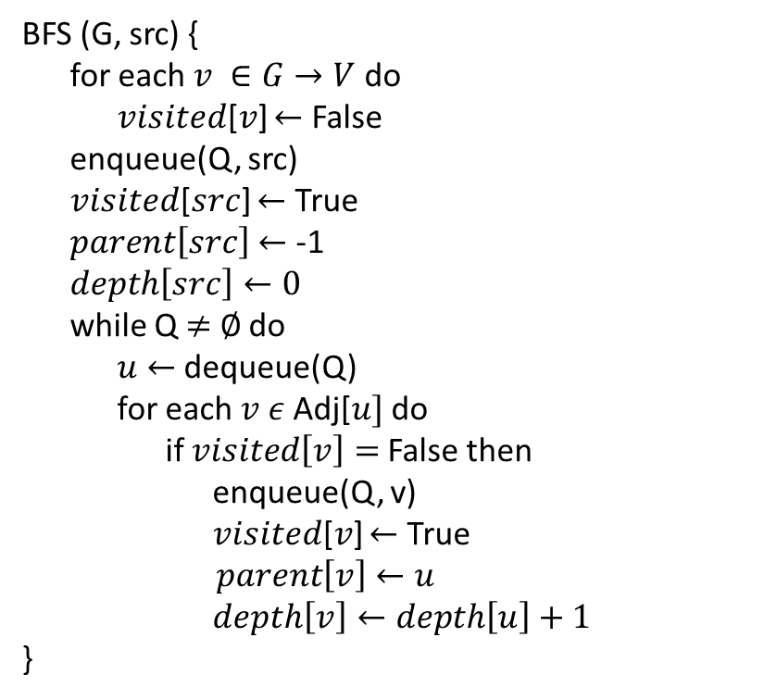
BFS - Algorithm
Initialization: Enqueue the source node into the queue and mark it as visited.
Exploration: While the queue is not empty:
Dequeue a node from the queue
For each unvisited neighbor of the dequeued node:
Enqueue the neighbor into the queue.
Mark the neighbor as visited.
Termination: Repeat step 2 until the queue is empty.
BFS (G, src) {
for each $v ∈G→V$do
𝑣𝑖𝑠𝑖𝑡𝑒𝑑[𝑣] $←$ False
enqueue(Q, src)
𝑣𝑖𝑠𝑖𝑡𝑒𝑑[$src$] $←$ True
$parent\left[src\right]$ $←$ -1
$depth\left[src\right]←0$
while Q $≠$ $∅$ do
$u$ $←$ dequeue(Q)
for each $v ε$Adj[$u]$ do
if $visited\left[v\right]=$False then
enqueue(Q, v)
𝑣𝑖𝑠𝑖𝑡𝑒𝑑[𝑣] $←$ True
$parent\left[v\right]$ $←u$
$depth\left[v\right]←depth\left[u\right]+1$
}

Slide 9
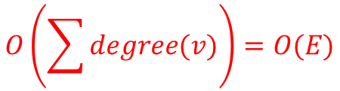

BFS – Algorithm (Time Complexity)
BFS (G, src) {
for each $v ∈G→V$do
𝑣𝑖𝑠𝑖𝑡𝑒𝑑[𝑣] $←$ False
enqueue(Q, src)
𝑣𝑖𝑠𝑖𝑡𝑒𝑑[src] $←$ True
$parent\left[src\right]$ $←$ -1
$depth\left[src\right]←0$
while Q $≠$ $∅$ do
$u$ $←$ dequeue(Q)
for each $v ε$Adj[$u]$ do
if $visited\left[v\right]=$False then
𝑣𝑖𝑠𝑖𝑡𝑒𝑑[𝑣] $←$ True
enqueue(Q, v)
$parent\left[v\right]$ $←u$
$depth\left[v\right]←depth\left[u\right]+1$
}
Touch every vertex: O(V)
Every vertex, but only once. (Why?)
$$O\left(\sum{degree(v)}\right)=O(E)$$
Total running time:
O(V + E)

Slide 10
BFS – Algorithm (Auxiliary Space Complexity)
BFS (G, src) {
for each $v ∈G→V$do
𝑣𝑖𝑠𝑖𝑡𝑒𝑑[𝑣] $←$ False
enqueue(Q, src)
𝑣𝑖𝑠𝑖𝑡𝑒𝑑[src] $←$ True
$parent\left[src\right]$ $←$ -1
$depth\left[src\right]←0$
while Q $≠$ $∅$ do
$u$ $←$ dequeue(Q)
for each $v ε$Adj[$u]$ do
if $visited\left[v\right]=$False then
𝑣𝑖𝑠𝑖𝑡𝑒𝑑[𝑣] $←$ True
enqueue(Q, v)
$parent\left[v\right]$ $←u$
$depth\left[v\right]←depth\left[u\right]+1$
}
Store every vertex: O(V)
Store every vertex, but only once. (Why?)
Total required auxiliary space:
O(V)

Slide 11
How Does the BFS Algorithm Work?
Step1: Initially queue is empty and all nodes are unvisited (here, 0 means unvisited and 1 means visited).
0 | 1 | 2 | 3 | 4
1
3
Visited
0 | 0 | 0 | 0 | 0
0
Queue
2
4
FRONT

Slide 12
How Does the BFS Algorithm Work?
Step 2: Push node 0 into queue and mark it visited.
0 | 1 | 2 | 3 | 4
1
3
Visited
1 | 0 | 0 | 0 | 0
0
Queue
0
2
4
FRONT

Slide 13
How Does the BFS Algorithm Work?
Step 3: Remove node 0 from the front of queue and visit the unvisited neighbours and push them into queue.
0 | 1 | 2 | 3 | 4
1
3
Visited
1 | 1 | 1 | 0 | 0
0
Queue
1 | 2
2
4
FRONT

Slide 14
How Does the BFS Algorithm Work?
Step 4: Remove node 1 from the front of queue and visit the unvisited neighbours and push them into queue.
0 | 1 | 2 | 3 | 4
1
3
Visited
1 | 1 | 1 | 1 | 0
0
Queue
2 | 3
2
4
FRONT

Slide 15
How Does the BFS Algorithm Work?
Step 5: Remove node 2 from the front of queue and visit the unvisited neighbours and push them into queue.
0 | 1 | 2 | 3 | 4
1
3
Visited
1 | 1 | 1 | 1 | 1
0
Queue
3 | 4
2
4
FRONT

Slide 16
How Does the BFS Algorithm Work?
Step 6: Remove node 3 from the front of queue and visit the unvisited neighbours and push them into queue.
0 | 1 | 2 | 3 | 4
1
3
Visited
1 | 1 | 1 | 1 | 1
0
Queue
4
2
4
FRONT

Slide 17
How Does the BFS Algorithm Work?
Step 7: Remove node 4 from the front of queue and visit the unvisited neighbours and push them into queue.
0 | 1 | 2 | 3 | 4
1
3
Visited
1 | 1 | 1 | 1 | 1
0
Queue
2
4
FRONT
Now, Queue becomes empty, So, terminate these process of iteration.

Slide 18
How Does the BFS Algorithm Work?
Output:
1
3
0
2
4
BFS Spanning Tree

Slide 19
BFS – disconnected Graph
?

Slide 20
BFS – Properties
BFS calculated the shortest-path distance to the source node.
BFS builds breadth-first spanning tree (forest), in which paths to root(s) represent shortest paths in G
Thus can use BFS to calculate shortest path from one vertex to another in O(V + E) time in an unweighted graph.

Slide 21
Depth-First Search
Depth-first search is another strategy for exploring a graph
Depth first Search or Depth first traversal is a recursive algorithm for searching all the vertices of a graph.
We divide the vertices into two categories:
Visited and
Not visited.
Initially all vertices will be not visited.
DFS employs a backtracking technique for traversing graphs and trees.

Slide 22
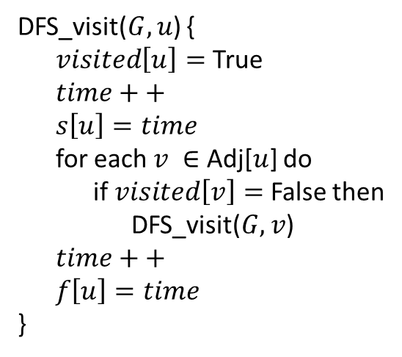
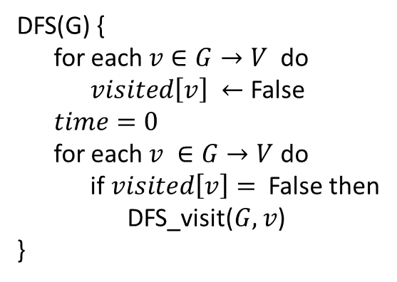
DFS - Algorithm
DFS(G) {
for each $v∈G→V$do
$visited\left[v\right] ←$ False
$time=0$
for each $v ∈G→V$ do
if $visited\left[v\right]=$ False then
DFS_visit($G, v$)
}
DFS_visit($G, u$) {
$visited\left[u\right]=$True
$time++$
$s\left[u\right]=time$
for each $v ∈$ Adj[$u$] do
if $visited\left[v\right]=$ False then
DFS_visit($G, v$)
$time++$
$f\left[u\right]=time$
}

Slide 23
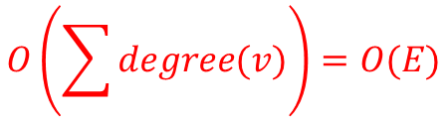
DFS – Algorithm (Time complexity analysis)
DFS(G) {
for each $v∈G→V$do
$visited\left[v\right] ←$ False
$time=0$
for each $v ∈G→V$ do
if $visited\left[v\right]=$ False then
DFS_visit($G, v$)
}
DFS_visit($G, u$) {
$visited\left[u\right]=$True
$time++$
$s\left[u\right]=time$
for each $v ∈$ Adj[$u$] do
if $visited\left[v\right]=$ False then
DFS_visit($G, v$)
$time++$
$f\left[u\right]=time$
}
$$O\left(\sum{degree(v)}\right)=O(E)$$
Touch every vertex: O(V)

Slide 24



DFS – Algorithm (Time complexity analysis)
DFS(G) {
for each $v∈G→V$do
$visited\left[v\right] ←$ False
$time=0$
for each $v ∈G→V$ do
if $visited\left[v\right]=$ False then
DFS_visit($G, v$)
}
DFS_visit($G, u$) {
$visited\left[u\right]=$True
$time++$
$s\left[u\right]=time$
for each $v ∈$ Adj[$u$] do
if $visited\left[v\right]=$ False then
DFS_visit($G, v$)
$time++$
$f\left[u\right]=time$
}
$$O(E)$$
Touch every vertex: O(V)
$$O(E)$$
Running time: O(V*E$)$

Slide 25
DFS – Algorithm (Time complexity analysis)
DFS(G) {
for each $v∈G→V$do
$visited\left[v\right] ←$ False
$time=0$
for each $v ∈G→V$ do
if $visited\left[v\right]=$ False then
DFS_visit($G, v$)
}
DFS_visit($G, u$) {
$visited\left[u\right]=$True
$time++$
$s\left[u\right]=time$
for each $v ∈$ Adj[$u$] do
if $visited\left[v\right]=$ False then
DFS_visit($G, v$)
$time++$
$f\left[u\right]=time$
}
$$O(E)$$
Touch every vertex: O(V)
$$O(E)$$
But, there is actually a tighter bound. How many times will DFS_visit() actually be called?

Slide 26
DFS – Algorithm (Time complexity analysis)
DFS(G) {
for each $v∈G→V$do
$visited\left[v\right] ←$ False
$time=0$
for each $v ∈G→V$ do
if $visited\left[v\right]=$ False then
DFS_visit($G, v$)
}
DFS_visit($G, u$) {
$visited\left[u\right]=$True
$time++$
$s\left[u\right]=time$
for each $v ∈$ Adj[$u$] do
if $visited\left[v\right]=$ False then
DFS_visit($G, v$)
$time++$
$f\left[u\right]=time$
}
$$O(E)$$
Touch every vertex: O(V)
$$O(E)$$
So, running time of DFS = O(V+E)

Slide 27
DFS – Algorithm (Space complexity analysis)
DFS(G) {
for each $v∈G→V$do
$visited\left[v\right] ←$ False
$time=0$
for each $v ∈G→V$ do
if $visited\left[v\right]=$ False then
DFS_visit($G, v$)
}
DFS_visit($G, u$) {
$visited\left[u\right]=$True
$time++$
$s\left[u\right]=time$
for each $v ∈$ Adj[$u$] do
if $visited\left[v\right]=$ False then
DFS_visit($G, v$)
$time++$
$f\left[u\right]=time$
}
Total required Auxiliary Space = O(V)

Slide 28
How Does the DFS Algorithm Work?
Source
vertex

Slide 29
How Does the DFS Algorithm Work?
Source
vertex
s
f
1

Slide 30
How Does the DFS Algorithm Work?
Source
vertex
s
f
1
2

Slide 31
How Does the DFS Algorithm Work?
Source
vertex
s
f
1
2
3

Slide 32
How Does the DFS Algorithm Work?
Source
vertex
s
f
1
2
3
4

Slide 33
How Does the DFS Algorithm Work?
Source
vertex
s
f
1
2
3
4
5

Slide 34
How Does the DFS Algorithm Work?
Source
vertex
s
f
1
2
3
4
5
6

Slide 35
How Does the DFS Algorithm Work?
Source
vertex
s
f
1
2
7
3
4
5
6

Slide 36
How Does the DFS Algorithm Work?
Source
vertex
s
f
1
8
2
7
3
4
5
6

Slide 37
How Does the DFS Algorithm Work?
Source
vertex
s
f
1
8
2
7
9
3
4
5
6

Slide 38
How Does the DFS Algorithm Work?
Source
vertex
s
f
1
8
2
7
9
10
3
4
5
6

Slide 39
How Does the DFS Algorithm Work?
Source
vertex
s
f
1
8
11
2
7
9
10
3
4
5
6

Slide 40
How Does the DFS Algorithm Work?
Source
vertex
s
f
1
12
8
11
2
7
9
10
3
4
5
6

Slide 41
How Does the DFS Algorithm Work?
Source
vertex
s
f
1
12
8
11
13
2
7
9
10
3
4
5
6

Slide 42
How Does the DFS Algorithm Work?
Source
vertex
s
f
1
12
8
11
13
2
7
9
10
3
4
5
6
14

Slide 43
How Does the DFS Algorithm Work?
Source
vertex
s
f
1
12
8
11
13
2
7
9
10
3
4
5
6
14
15

Slide 44
How Does the DFS Algorithm Work?
Source
vertex
s
f
1
12
8
11
13
16
2
7
9
10
3
4
5
6
14
15

Slide 45
How Does the DFS Algorithm Work?
DFS introduces an important distinction among edges in the original graph:
Source
vertex
s
f
1
12
8
11
13
16
2
7
9
10
3
4
5
6
14
15

Slide 46
How Does the DFS Algorithm Work?
DFS introduces an important distinction among edges in the original graph:
Source
vertex
s
f
1
12
8
11
13
16
2
7
9
10
3
4
5
6
14
15
Tree Edge

Slide 47
How Does the DFS Algorithm Work?
DFS introduces an important distinction among edges in the original graph:
Source
vertex
s
f
1
12
8
11
13
16
2
7
9
10
3
4
5
6
14
15
Back Edge: from descendent to ancestor

Slide 48
How Does the DFS Algorithm Work?
DFS introduces an important distinction among edges in the original graph:
Source
vertex
s
f
1
12
8
11
13
16
2
7
9
10
3
4
5
6
14
15
Forward Edge: from ancestor to descendent (not a tree edge though)

Slide 49
How Does the DFS Algorithm Work?
DFS introduces an important distinction among edges in the original graph:
Source
vertex
s
f
1
12
8
11
13
16
2
7
9
10
3
4
5
6
14
15
Cross Edge: between trees or between subtrees

Slide 50
How Does the DFS Algorithm Work?
DFS introduces an important distinction among edges in the original graph:
Source
vertex
s
f
1
12
8
11
13
16
2
7
9
10
3
4
5
6
14
15
Tree Edges Back edges Forward edges Cross edges
Note: tree and back edges are very important; some algorithms use forward and cross edges

Slide 51
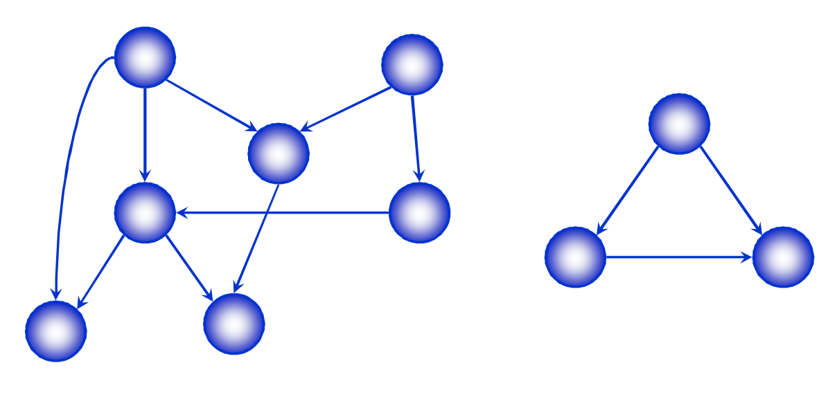
Directed Acyclic Graphs
A directed acyclic graph or DAG is a directed graph with no directed cycles

Slide 52
Topological Sort
A topological sort of a DAG is
A linear ordering of all vertices of the graph G such that vertex u comes before vertex v if (u, v) is an edge in G.
DAG indicates precedence among events:
Events are graph vertices, edge from u to v means event u has precedence over even v.
Real-world example:
Course registration
Tasks for eating meal

Slide 53
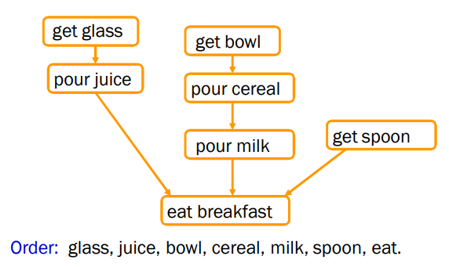
Precedence Example
Tasks that have to be done to eat breakfast:
Get glass, pour juice, get bowl, pour cereal, pour milk, get spoon, eat.
Certain evens must happen in a certain order (ex: get bowl before pouring milk)
For other evens, it doesn’t matter (ex: get bowl and get spoon)

Slide 54
Why Acyclic?
Why must directed graph by acyclic for the topological sort problem?
Otherwise, no way to order events linearly without violating a precedence constraint.

Slide 55
Topological Sort: Using In-degree
Steps for finding the topological ordering of DAG:
Step-1: Compute in-degree for each of the vertices present in the DAG and initialize the count of visited nodes as 0;
Step-2: Add all vertices with in-degree equal 0 into a queue
Step-3: Remove a vertex from the queue and then
Increment count of visited nodes by 1;
Decrease in-degree by 1 for all its neighboring nodes;
If in-degree of a neighboring node is reduced to zero, then add it to the queue;
Step-4: Repeat Step-3 until the queue is empty;
Step 5: If count of visited nodes is not equal to the number of nodes in the graph then the topological sort is not possible for the given graph.

Slide 56
Topological Sort: Using In-degree
0
1
2
4
5
3

Slide 57
Topological Sort: Using In-degree
0
1
2
4
5
3
Queue: 0
In degree
0 | 1 | 1 | 3 | 2 | 3
0 | 1 | 2 | 3 | 4 | 5
Sequence:

Slide 58
Topological Sort: Using In-degree
1
2
4
5
3
Queue: 1
In degree
0 | 0 | 1 | 2 | 2 | 3
0 | 1 | 2 | 3 | 4 | 5
Sequence: 0

Slide 59
Topological Sort: Using In-degree
2
4
5
3
Queue: 2
In degree
0 | 0 | 0 | 1 | 2 | 3
0 | 1 | 2 | 3 | 4 | 5
Sequence: 0 1

Slide 60
Topological Sort: Using In-degree
4
5
3
Queue: 3
In degree
0 | 0 | 0 | 0 | 1 | 2
0 | 1 | 2 | 3 | 4 | 5
Sequence: 0 1 2

Slide 61
Topological Sort: Using In-degree
4
5
Queue: 4
In degree
0 | 0 | 0 | 0 | 0 | 1
0 | 1 | 2 | 3 | 4 | 5
Sequence: 0 1 2 3

Slide 62
Topological Sort: Using In-degree
5
Queue: 5
In degree
0 | 0 | 0 | 0 | 0 | 0
0 | 1 | 2 | 3 | 4 | 5
Sequence: 0 1 2 3 4

Slide 63
Topological Sort: Using In-degree
Queue:
In degree
0 | 0 | 0 | 0 | 0 | 0
0 | 1 | 2 | 3 | 4 | 5
Sequence: 0 1 2 3 4 5

Slide 64
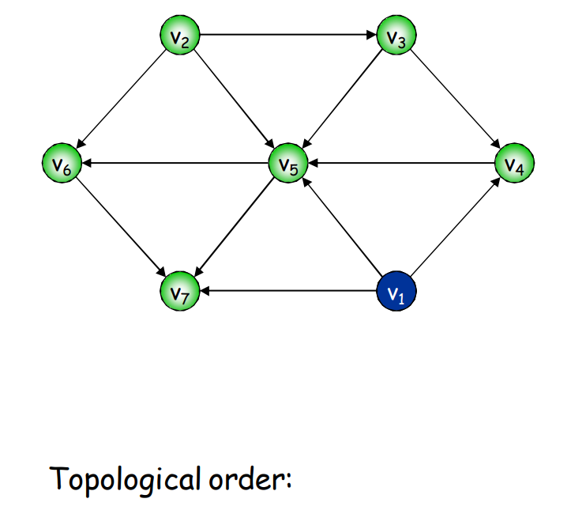
Topological Sort: Using In-degree
??

Slide 65
Thank You
Questions

